Slide 1


Slide 2
Background

Slide 3

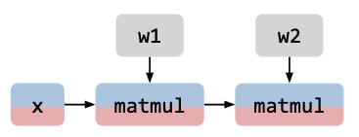
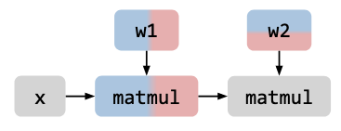
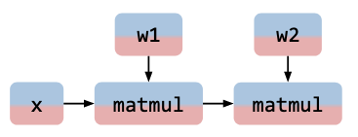
Distributed Machine Learning
Machine
Machine
Data
Data
Data
Machine
Machine
Data
Data
Data
Machine
Machine
Data Parallel
Model Parallel
Tensor Parallel
One code snippet rules them all!
X (Row, Column, Matrix[][])
W (Row, Column, Matrix[][])
SELECT X.Row, W.Col,
SUM (matrix_multiply (X.Matrix, W.Matrix))
FROM X, W
WHERE X.Col = W.Row
GROUP BY X.Row, W.Col
Notes:
Talk about what is distributed ML and STOA of distributed ML.

Slide 4
Database for Distributed Machine Learning
Consider a simple matrix multiplication of two large matrices A and B:
Machine 1
Machine 2
[Luo et al, ICDE’17]
Matrix A
Matrix B
Partition A & B:
Shuffle A & Shuffle B:
Machine 1 & 2:
Machine 1
Machine 2
A(0,0)
A(0,1)
B(0,0)
B(0,1)
A(0,0)
A(0,1)
B(0,0)
B(0,1)
A(0,0)
A(0,1)
A(1,0)
A(1,1)
A(1,0)
A(1,1)
B(1,0)
B(1,1)
A(1,0)
A(1,1)
B(1,0)
B(1,1)
B(0,0)
B(1,0)
B(0,1)
B(1,1)

Slide 5
Database for Distributed Machine Learning
Consider a simple matrix multiplication of one large matrix A and one small matrix B:
Machine 1
Machine 2
[Luo et al, ICDE’17]
Matrix A
Matrix B
Partition A:
Shuffle A & Broadcast B:
Machine 1 & 2:
B
Machine 1
Machine 2
A(0,0)
A(0,1)
B
A(0,0)
A(0,1)
B
B
A(0,0)
A(1,0)
A(1,0)
A(1,1)
A(1,0)
A(1,1)
A(0,1)
A(1,1)
All the partition, distribution and execution don’t require user’s involvement!

Slide 6
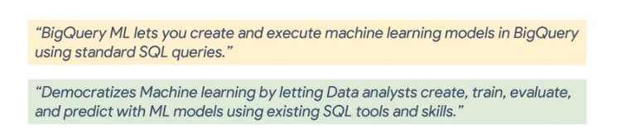
Database for Distributed Machine Learning
Declarative Interface like SQL
Automatic Parallelization, Distribution and Optimization
No data export/import overhead
Easy to scale to large-scale datasets and models

Slide 7
Motivation
There are many benefits running ML applications on a database
However, other ML platforms (PyTorch, Tensorflow and JAX) are so popular
Automatic evaluation of gradients - Auto Differentiation!
All modern relational database engines are Relational Algebra (RA) engines
SQL is compiled into RA
Executing relational operations (joins, aggregations and so on) over relations (tables)
However, current auto-diff algorithm are only based on Linear Algebra, not Relational Algebra!
Without adding auto-diff capability to database engines, relational databases are unlikely to capture much market share in ML, even for applications to which they are uniquely suited.
[Woznica et al, KDD’05, Li et al, VLDB’17, Jayaram et al, ICML’21]
Notes:
Talk about why database is a good platform for distributed ML. Pros and Cons? One of the cons is that db doesn’t support auto-differentiation which is a key functionality in ML systems.

Slide 8
Auto Differentiation: A Primer
Consider a complicated function
$$F:R^{n}→R^{m},\text{x}∈R^{n}$$
$$F(\text{x})=F_{4}(F_{3}(F_{2}(F_{1}(\text{x}))))$$
Differentiate a function from a human’s perspective
$$∇F(\text{x})=\frac{∂F_{4}({\text{x}}_{4})}{∂{\text{x}}_{4}}⋅\frac{∂F_{3}({\text{x}}_{3})}{∂{\text{x}}_{3}}⋅\frac{∂F_{2}({\text{x}}_{2})}{∂{\text{x}}_{2}}⋅\frac{∂F_{1}(\text{x})}{∂\text{x}}=J_{F_{4}}({\text{x}}_{4})⋅J_{F_{3}}({\text{x}}_{3})⋅J_{F_{2}}({\text{x}}_{2})⋅J_{F_{1}}(\text{x})$$
Differentiate a function from a computer’s perspective
Forward Mode AD:
Reverse Mode AD:
$$J_{F}⋅\text{v}=J_{F_{4}}({\text{x}}_{4})(J_{F_{3}}({\text{x}}_{3})(J_{F_{2}}({\text{x}}_{2})(J_{F_{1}}(\text{x})(\text{v})))),\text{v}∈R^{n}$$
$${\text{u}}^{\text{T}}⋅J_{F}=(\text{u})^{\text{T}}J_{F_{4}}({\text{x}}_{4})J_{F_{3}}({\text{x}}_{3})J_{F_{2}}({\text{x}}_{2})J_{F_{1}}(\text{x}),\text{u}∈R^{m}$$
we re-write $F(\text{x})$ as ${\text{x}}_{2}←F_{1}(\text{x}),{\text{x}}_{3}←F_{2}({\text{x}}_{2}),{\text{x}}_{4}←F_{3}({\text{x}}_{3}),F(\text{x})←F_{4}({\text{x}}_{4})$
Notes:
Talk a little bit about what is auto differentiation. Introduce it.

Slide 9
Auto Differentiation: A Primer
Forward
$$w$$
$$z$$
import tangent
import numpy as np
def f(x1,x2):
w = np.sin(x2) * (np.log(x1 * x2))
z = w/2
return z
*
$$y_{1}$$
$$y_{2}$$
Log
Sin
$$x_{3}$$
*
$$x_{1}$$
$$x_{2}$$
Tangent: Automatic differentiation using source-code transformation for dynamically typed array programming
Notes:
Talk about all the systems that currently support auto-diff.

Slide 10
Auto Differentiation: A Primer
def dfdx1(x1, x2, bz=1.0):
x1_times_x2 = x1 * x2
_w = np.log(x1_times_x2)
np_sin_x2 = np.sin(x2)
w = np_sin_x2 * _w
z = w / 2
_bw = bz / 2
bw = _bw
_b_w = tangent.unbroadcast(bw * np_sin_x2, _w)
b_w = _b_w
_bx1_times_x2 = b_w / x1_times_x2
bx1_times_x2 = _bx1_times_x2
_bx1 = tangent.unbroadcast(bx1_times_x2 * x2, x1)
bx1 = _bx1
return bx1
Forward
$$w$$
$$z$$
$$\frac{∂z}{∂w}$$
*
MultiBackward
$$\frac{∂z}{∂y_{1}}$$
$$\frac{∂z}{∂y_{2}}$$
$$y_{1}$$
$$y_{2}$$
Log
Sin
LogBackward
SinBackward
$$\frac{∂z}{∂x_{3}}$$
$$x_{3}$$
*
MultiBackward
$$\frac{∂z}{∂x_{1}}$$
$$\frac{∂z}{∂x_{2}}$$
Backward
$$x_{1}$$
$$x_{2}$$
Notes:
Talk about all the systems that currently support auto-diff.

Slide 11
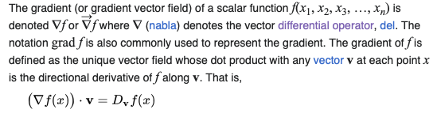
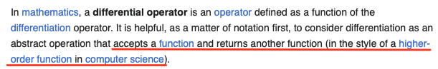
Recap: Gradients and Differential Operator
Linear Algebra (LA) has been defined to build up functions.
However, Relational Algebra (RA) is only defined in an operator view.
We need a version of Relational Algebra that can build functions!
Notes:
Talk about the definition of derivatives and gradients.

Slide 12
Contribution #1: Functional Relational Algebra

Slide 13
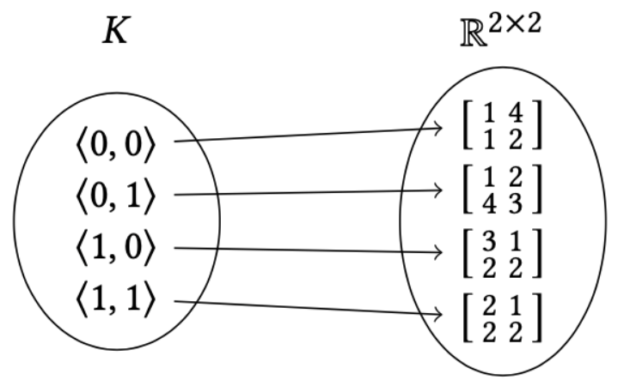
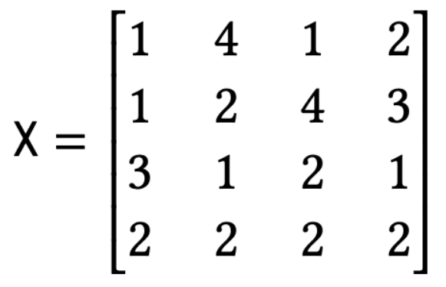

Functional Relational Algebra
key set
value set
A relation is a function from a set of keys to a set of values.
Select($σ$), Join($⋈$), Aggregation($Σ$), TableScan($τ$) are all high-order functions that take relations (functions) as input and output another relation (function).
TableScan($τ$)
Aggregation($Σ$)
Type Signature:
Definition:
Type Signature:
Definition:
$$τ:K→(F(K)→F(K))$$
$$Σ:(\left(K_{in}→K_{out}\right)×\left(R→R\right)×\left(F(K_{1},...,K_{n})→F(K_{in})\right))→(F(K_{1},...,K_{n})→F(K_{out}))$$
$$τ(K)↦\left(\left(\text{R}\right)↦\text{R}\right)$$
$$Σ\left(\text{grp},⊕,Q\right)↦(\left(R_{1},R_{2},...,R_{n}\right)↦\{\left(\text{key},\text{value}\right)\text{s.t. for}\text{key}∈K_{out}\text{and}Q^{′}=Q(R_{1},R_{2},...,R_{n}),\text{value}=⊕\left\{Q^{′}(\text{keyIn})\text{s.t.}\text{grp}\left(\text{keyIn}\right)=\text{key}\right\}\})$$
$F(K)$ to be the set of all functions from key set $K$ to $R$
Notes:
Key set value what is a relation key to value mapping. Show a simple identity function like tableScan.

Slide 14
Logistic Regression: an example
With functional relational operators, we can easily build functions
For example, a simple logistic regression:
Features are stored in ${\text{R}}_{\text{x}}∈F(\text{rowID}×\text{colID})$
Labels are stored in ${\text{R}}_{\text{y}}∈F(\text{rowID})$
Coefficients are in $F(\text{colID})$
A function $Q_{loss}:F(\text{colID})→F(\{⟨⟩\})$ can be easily built.
$$\text{Loss}$$
$$Σ$$
$$⋈$$
$$σ$$
$${\text{R}}_{y}$$
$$Σ$$
$$⋈$$
$${\text{R}}_{x}$$
$$τ$$
$${\text{R}}_{θ}$$
Notes:
Key set value what is a relation key to value mapping. Show a simple identity function like tableScan.

Slide 15
Contribution #2: Differential Calculus for Relational Algebra

Slide 16
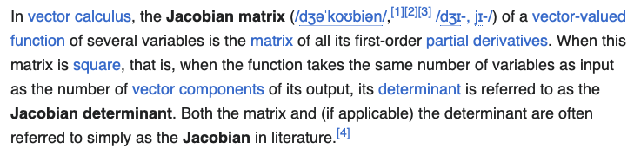
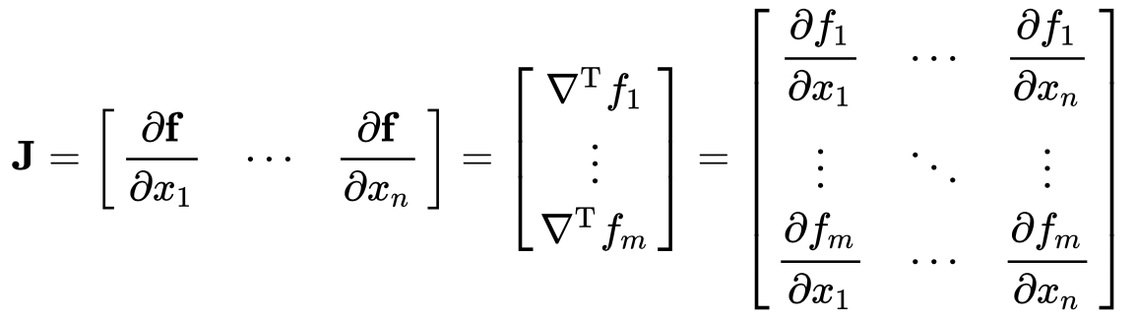
Recap: Jacobian and vector-Jacobian Product (VJP)
The Jacobian is the matrix of partial derivatives:
The backprop equation (single node) can be written as a vector-Jacobian product (VJP)
Matrix-vector Product
$$z=Wx$$
$$J=W$$
$$\overline{x}=W^{⊺}\overline{z}$$
$$\overline{x_{j}}=\underset{i}{∑}\overline{y_{i}}\frac{∂y_{i}}{∂x_{j}}$$
$$\overline{x}={\overline{y}}^{⊺}J$$
$$\overline{x}=J^{⊺}\overline{y}$$
Element-wise operation
$$z=exp(x)$$
$$\overline{x}=exp(x)∘\overline{z}$$
$$J=diag(exp(x))$$
Notes:
Explain what is an jacobian

Slide 17
Relation-Jacobian Product (RJP)
We derive Relation-Jacobian Products (RJP) for Relational Operators
Efficient implementation of RJP rules without explicit materialization of Jacobian
analogous to Vector-Jacobian Product (VJP) in Linear Algebra
Relation-Jacobian Products:
Relation-Jacobian Products:
TableScan($τ$)
Aggregation($Σ$)
$$RJP_{τ}(K)↦(({\text{R}}_{o},{\text{R}}_{i})↦{\text{R}}_{o})$$
$$RJP_{Σ}(\text{grp},⊕,K_{o},K_{i})≡⋈(\text{pred},\text{proj},⊗,τ(K_{o}),τ(K_{i}))$$
Relation-Jacobian Products:
$$RJP_{σ}(\text{pred},\text{proj},⊙,K_{o},K_{i})≡⋈({\text{pred}}^{′},{\text{proj}}^{′},⊗^{′},τ(K_{o}),τ(K_{i}))$$
Relation-Jacobian Products:
$$RJP_{⋈}(\text{pred},\text{proj},⊗,K_{o},K_{l},{\text{R}}_{r})≡Σ(\text{grp},⊕(⋈({\text{pred}}_{1},{\text{proj}}_{1},⊗_{1},τ(K_{o}),⋈_{\text{const}}({\text{pred}}_{2},{\text{proj}}_{2},⊗_{2},τ(K_{l}),{\text{R}}_{r}))))$$
Select($σ$)
Join($⋈$)
Notes:
We do not want to explicitly materialize because Jacobian is normally in high dimensions and with high sparsity.

Slide 18
Optimization for RJPs
Optimization for Join($⋈$) RJP
First $⋈_{\text{const}}$ operation in RJP can be optimized out [⊗ is × (or MatMul)]
Final $Σ$ operation in RJP can be optimized out based on different join cardinality relationships [one-to-one, one-to-many relationship]
When a join-agg-tree structure (a join followed by an aggregation) appears in the query graph, differentiating the aggregation operator is unnecessary
[Jankov et al, VLDB’21]
Optimization for Aggregation($Σ$) RJP
The $⋈$ operation in RJP can be simplified into a single $σ$ operation [$(\text{key})↦⟨⟩$]
Notes:
Talk about RJP.

Slide 19
Implications from RJPs
Relational Algebra (RA) is more general than Linear Algebra (LA)
RA is flexible for key, value manipulation (LA’s key is fixed)
RA is flexible to apply different User-Defined Function (LA use default multiply/add)
RA can associate variables in a more direct way (LA is indirect, restricted by tensor ops)
The tradeoff is, RA use more operators to express the same computation
Better scalability and easy to run computations out-of-core
Good fit for distributed execution
Notes:
Talk about RJP.

Slide 20
Contribution #3: Relational Algebra Auto Differentiation

Slide 21
Chain Rule for Queries
Take an operator’s input ${\text{R}}_{in}$ and output gradients $\frac{∂\text{Loss}}{∂{\text{R}}_{out}}$
Call the corresponding RJP
$$\text{Loss}$$
Forward
Backward
$$Σ$$
$$\frac{∂\text{Loss}}{∂{\text{R}}_{out}}$$
$${\text{R}}_{out}$$
$${\text{R}}_{in}$$
$$⋈$$
$$σ$$
$${\text{R}}_{y}$$
$$Σ$$
$$⋈$$
$${\text{R}}_{x}$$
$$τ$$
$${\text{R}}_{θ}$$
Notes:
Talk about RJP.

Slide 22
Relational Algebra Auto-differentiation
RJP for $Σ$
Topologically sort the query graph
Reverse traverse the query graph
Use chain rule to call the corresponding RJP
Add RJP computation back to the graph
If there are multiple adjoints, merge them
Forward
$$\text{Loss}$$
Backward
$$σ$$
$$Σ$$
RJP for $⋈$
$$⋈$$
$$⋈$$
$$⋈$$
$$σ$$
$${\text{R}}_{y}$$
RJP for $σ$
$$⋈$$
$$Σ$$
RJP for $Σ$
$$⋈$$
$$⋈$$
$$⋈$$
RJP for $⋈$
$${\text{R}}_{x}$$
$$τ$$
$${\text{R}}_{θ}$$
$$Σ$$
$$\frac{∂Q}{∂{\text{R}}_{θ}}$$
Notes:
Talk about RJP.

Slide 23
Contribution #4: Evaluation of sparse ML on Relational Engine

Slide 24
Experiment Setup
A relational system, equipped with this auto-diff technology, could show better scalability than other systems?
Three benchmarks on a high-performance relational engine - PlinyCompute*
Non-Negative Matrix Factorization (NNMF)
Graph Convolutional Networks (GCN)
Large-scale Knowledge Graph Embeddings (KGE)
A Python tool for relational computation auto-differentiation
Generated auto-diff computation can be easily imported to a relational engine
AWS m5.4xlarge instances (1 to 16 nodes)
Intel Xeon Platinum CPU with 20 cores
64GB DDR4 memory, 512GB general SSD
[Jia et al, SIGMOD’18]
*All the RA operators, RJP rules and related implementation can be easily incorporated into any relational system.
Notes:
Talk about RJP.

Slide 25
Scalability
Non-Negative Matrix Factorization: Better scalability than MPI and Dask
Graph Convolutional Networks
On ogbn-papers100M (0.1B, 1.6B) & friendster (65.6M, 3.6B), better than DGL and Aligraph
Large-scale Knowledge Graph Embeddings (KGE): Better scalability than DGL-KE
ogbn-papers100M epoch time
friendster epoch time
time
(Second)
time
(Second)
OOM
OOM
OOM
OOM
OOM
OOM
OOM
OOM
OOM
OOM
OOM
OOM
OOM
OOM
Number of nodes
Number of nodes
Notes:
Talk about RJP.

Slide 26
Contribution #5: Dense/sparse computation on Relational Engine

Slide 27
Future Work: Motivation
Relational Engine can solve the scalability issues of sparse ML computations
However, it requires an expert to figure out how to implement them
How to represent the data/model? Which part should be stored as dense or sparse?
How to separate the dense and sparse part of a computation?
How to implement sparse computation in a relational view?
Notes:
Talk about RJP.

Slide 28
Graph Convolution as an example
Bad way:
Features (mat MATRIX [][])
Adjacency (mat MATRIX [][])
Weight (mat MATRIX [][])
SELECT ReLU(MAT_MUL (Weight.mat, MAT_MUL(Features.mat, Adjacency.mat))
FROM Features, Adjacency, Weight
Dense Representation
Dense Computation
Good way:
Dense Representation
Dense Computation
Node (ID INT , vec VECTOR [2048])
Edge (sourceID INT , destID INT )
SELECT n1.ID as n.ID , ReLU(MAT_MUL(AVG( Normalize(n2.vec)))) as n.vec
FROM Node as n1 , Edge as e , Node as n2
WHERE n1.ID = e.sourceID and n2.ID = e.destID
GROUP BY n1.ID
Sparse Representation
Sparse Computation
Notes:
Talk about RJP.

Slide 29
Future Work
An algorithmic, automatic way to represent data and encode ML computations
Represent data/model properly in relations through schema rewriting
Separate dense computation and sparse computation
Make the best use of execution engine to run the computation efficiently
Compare with the state-of-the-art ML systems
PyTorch, DeepSpeed, Colossal-AI
Notes:
Talk about RJP.

Slide 30
Summary
Contribution #1: Functional Relational Algebra
Contribution #2: Differential Calculus for Relational Algebra
Contribution #3: Relational Algebra Auto Differentiation
Contribution #4: Evaluation of sparse ML on Relational Engine
Contribution #5: Dense/sparse computation on Relational Engine
Notes:
Talk about RJP.

Slide 31
Thank you!
Notes:
Talk about RJP.

Slide 32
Backup Slide
Select($σ$)
Type Signature:
Definition:
$$σ:(\left(K_{i}→\{\text{true},\text{false}\}\right)×\left(K_{i}→K_{o}\right)×\left(R→R\right)×\left(F(K_{1},K_{2},...,K_{n})→F(K_{i})\right))→\left(F(K_{1},K_{2},...,K_{n})→F(K_{o})\right)$$
$$σ(\text{pred},\text{proj},⊙,Q)↦(\left(R_{1},...,R_{n}\right)↦\{\left(\text{proj}(\text{key}),\text{value}\right)\text{s.t.}\text{pred}(\text{key})=\text{true})∧\text{for}Q^{′}=Q(R_{1},...,R_{n}),\text{value}=⊙\left(Q^{′}(\text{key})\right)\})$$
Join($⋈$)
Type Signature:
Definition:
$$⋈:(\left(K_{l}×K_{r}→\{\text{true},\text{false}\}\right)×\left(K_{l}×K_{r}→K_{o}\right)×\left(R×R→R\right)×\left(F(K_{l_{1}},K_{l_{2}},...,K_{l_{n}}))→F(K_{l})\right)×(F(K_{r_{1}},K_{r_{2}},...,K_{r_{m}}))→F(K_{r})))→(F(K_{l_{1}},...,K_{l_{n}},K_{r_{1}},...,K_{r_{m}})→F(K_{o}))$$
$$⋈(\text{pred},\text{proj},⊗,Q_{l},Q_{r})↦(\left(R_{l_{1}},...,R_{l_{n}},R_{r_{1}},...,R_{r_{m}}\right)↦\{\left(\text{key},\text{value}\right)\text{s.t. for}\text{key}∈K_{o}\text{and}Q_{l}^{′}=Q_{l}(R_{l_{1}},...,R_{l_{n}})\text{and}Q_{r}^{′}=Q_{r}(R_{r_{1}},...,R_{r_{m}}),\text{value}=⊗\left(Q_{l}^{′}(\text{keyInL}),Q_{r}^{′}(\text{keyInR})\right)\text{s.t.}\text{pred}(\text{keyInL},\text{keyInR})=\text{true}∧\text{proj}(\text{keyInL},\text{keyInR})=\text{key}\})$$
Notes:
Talk about RJP.

Slide 33
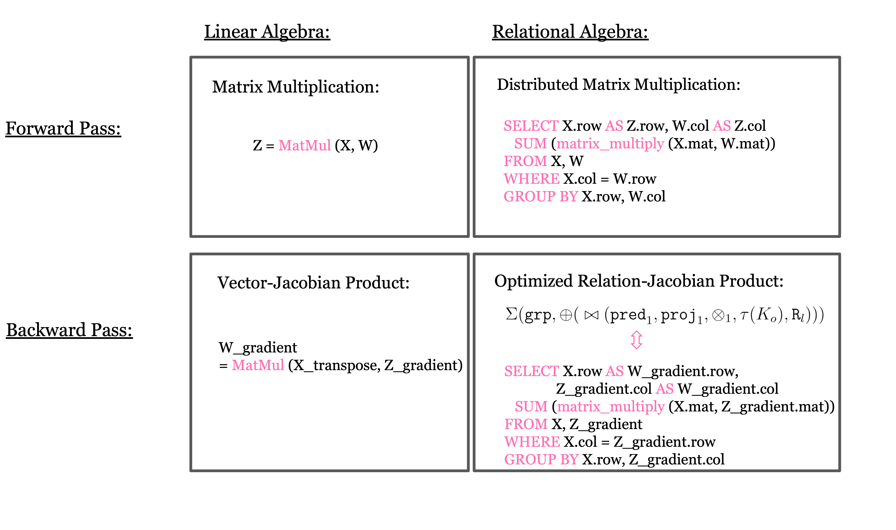
Backup Slide
Notes:
Talk about RJP.

Slide 34
Scalability - NNMF
Non-Negative Matrix Factorization: N is # of nodes, D is embedding size
N=40k, D=40k
N=50k, D=40k
time
(Second)
OOM
time
(Second)
OOM
OOM
OOM
Number of nodes
Number of nodes
N=60k, D=10k
N=10k, D=60k
time
(Second)
time
(Second)
OOM
OOM
OOM
OOM
OOM
OOM
OOM
Number of nodes
Number of nodes
Notes:
Talk about RJP.

Slide 35
Scalability - GCN
Two large graph datasets: ogbn-papers100M (0.1B, 1.6B), friendster (65.6M, 3.6B)
ogbn-papers100M epoch time
friendster epoch time
time
(Second)
time
(Second)
OOM
OOM
OOM
OOM
OOM
OOM
OOM
OOM
OOM
OOM
OOM
OOM
OOM
OOM
Number of nodes
Number of nodes
Notes:
Talk about RJP.

Slide 36
Scalability - KGE
Large knowledge graph: Freebase (TransE & TransR)
Results are based on different embedding size
TransE
TransR
time
(Second)
time
(Second)
OOM
OOM
OOM
OOM
OOM
OOM
Number of nodes
Number of nodes
Notes:
Talk about RJP.

Slide 37
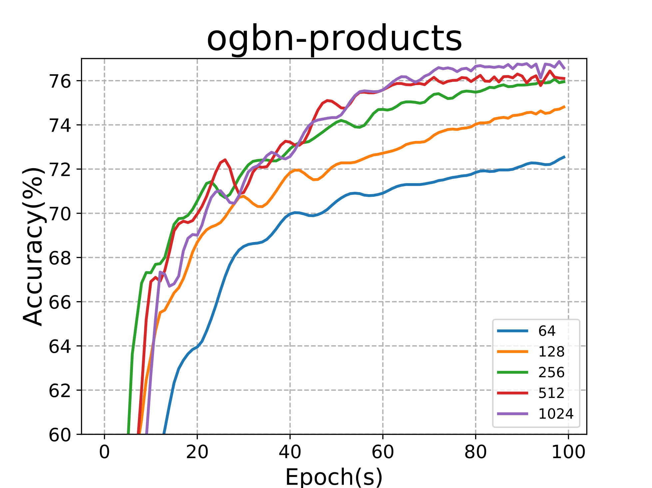
Accuracy - GCN
Boost performance through Large Embedding (64 to 1024 embedding vectors)
1024 embedding can only be handled by RA-GCN
Notes:
Talk about RJP.

Slide 38
Conclusion
Propose a functional version of Relational Algebra (RA)
Define partial derivative, gradients of a RA function
Define Relational Jacobian Product (RJP) of RA function
Propose a RA-autodiff algorithm
Generate RA function evaluating gradient of input RA function
Implement RA auto-diff algorithm to automatically produce distributed ML computations in a fully declarative way
Notes:
Talk about RJP.

Slide 39

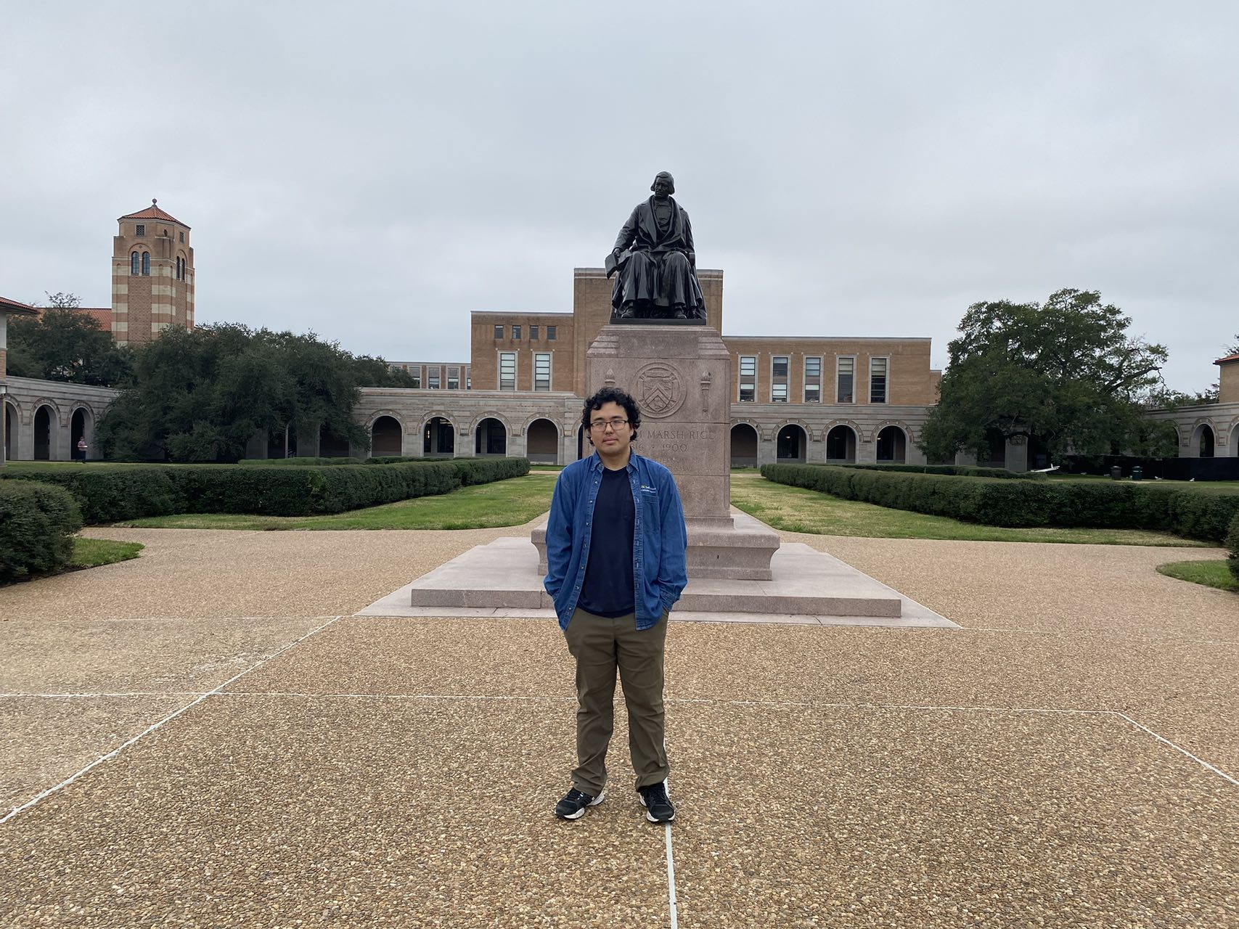

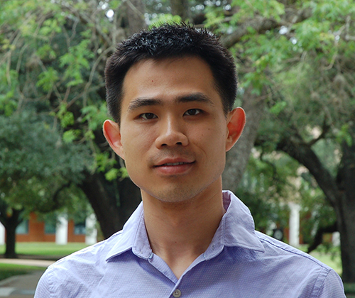

Acknowledgement
Committee members:
Collaborators:
Advisor:
Notes:
Talk about RJP.

